Slide 1


Mohammad Ehsani
Customer Churn Analysis and Prediction
SW and methods for statistical analysis of economic data
20 June, 2025

Slide 2




Project Objectives
Predict Customer Churn
Compare ML Models
Improve Customer Retention
Ensure Explainability
Build a model to identify customers likely to leave the service, and discover key features.
Evaluate logistic regression, SVM, and random forest for performance and interpretability.
Provide actionable insights to help the business reduce
churn.
Use LIME and SHAP to explain both global and individual model decisions.

Slide 3

Understanding the Data
Rows: 6687 customer records
16 Categorical & 13 Numerical
Columns: 29 variables including:
Demographics: age, state, gender.
Service Info: contract type, internet plan, international plan.
Usage Metrics: monthly charge, total charges, avg. GB download.
Support Metrics: customer service calls.
Churn Details: churn label, churn reason, churn category.

Slide 4
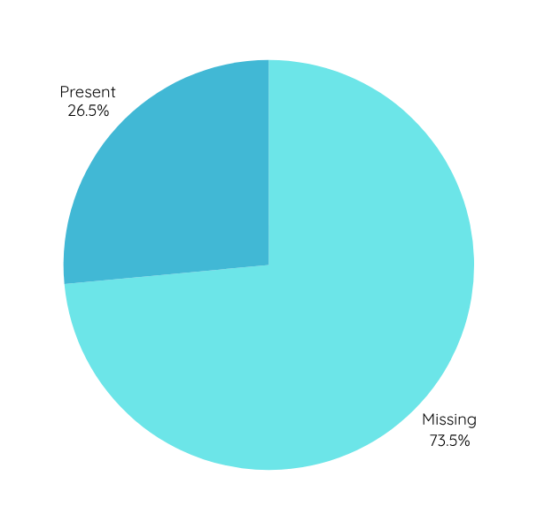
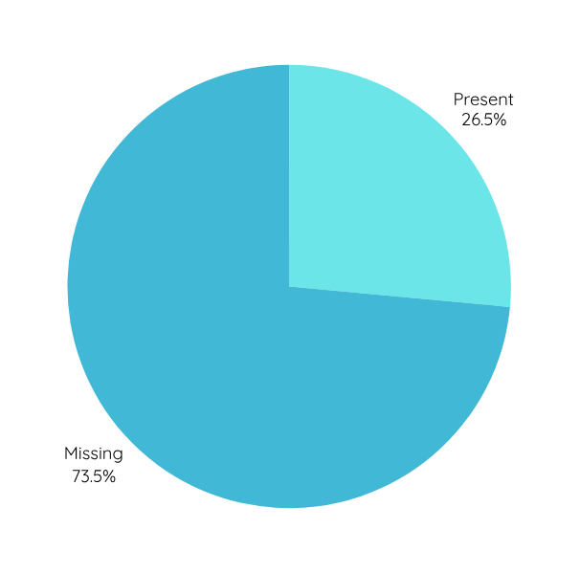
Handling Missing Data
Churn Reason
Missing data wasn’t extensive, but some important columns like churn reason had gaps.
Custom check for “NA”, blanks and “”.
Churn Category

Slide 5
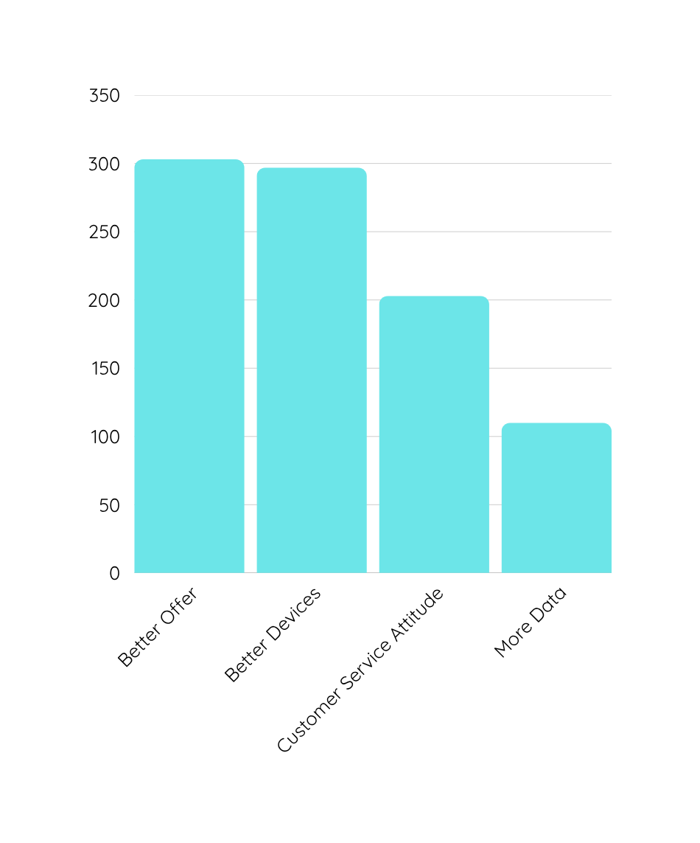
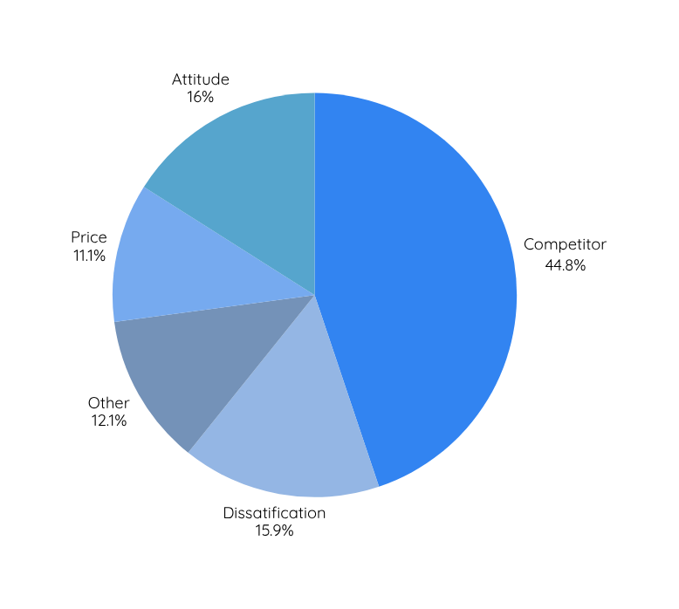
Churn Reason
Total Number of Customers: 6687
Total Number of Churned Customers: 1796
Rate of Churned Customers: 26.86 %
The most cited reason was competitors, which is actionable insight for business
Churn Category

Slide 6
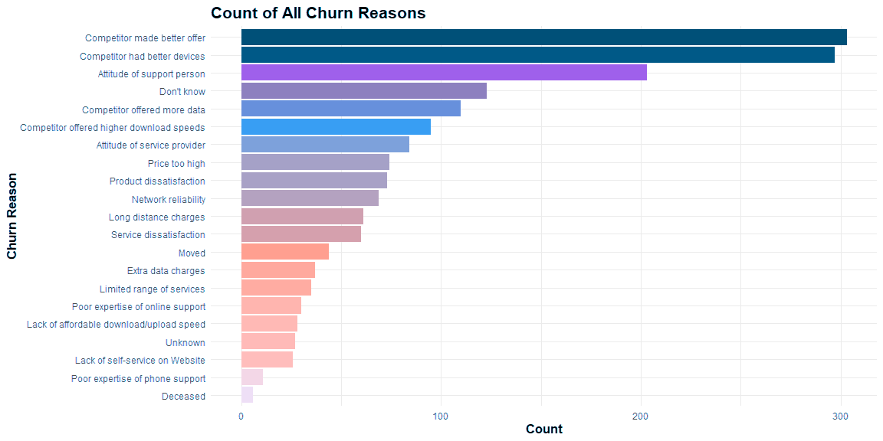

Slide 7
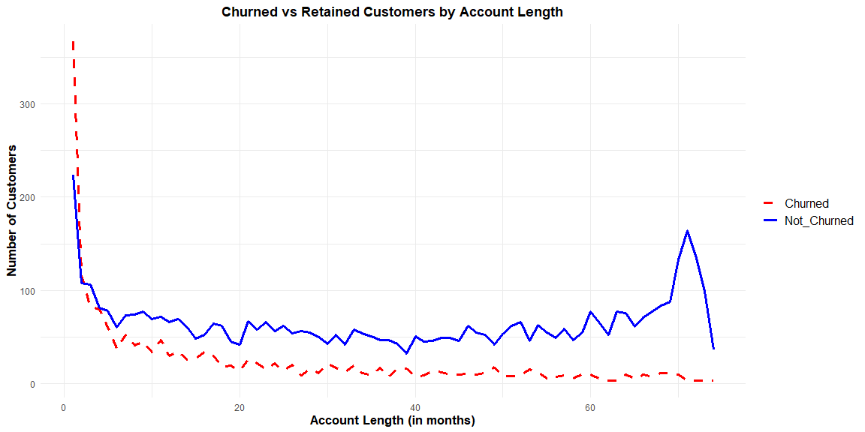
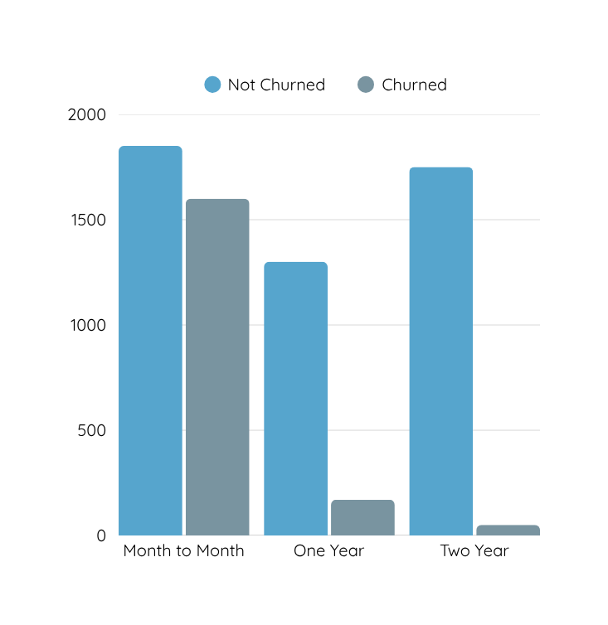
Contract Type

Slide 8

Feature Engineering
Dropped Irrelevant Columns:
Removed identifiers: customer id, phone number, etc.
Dropped high-missing explanation fields not used for prediction: state, etc
Transformed Features:
One-Hot Encoding:
Converted categorical variables (e.g., contract type, intl plan) into numeric format using one-hot encoding.
Scaling:
Standardized numeric features to zero mean and unit variance.
Target Variable
Converted churn label to a binary factor: Yes vs No

Slide 9

Model Building
Selected Algorithms:
Logistic Regression
Support Vector Machine (SVM)
Random Forest
Why These Models?
Represent a balance between interpretability and predictive power.
Allow meaningful comparison of linear vs. non-linear approaches.
Workflow:
Used tidymodels to streamline model creation, tuning, and evaluation.
Built separate workflows for each model using the same preprocessing recipe.

Slide 10



Hyperparameter Tuning
Cross-Validation Strategy
Tuning Grids
Implementation Plan
Used 5-fold cross-validation on training data.
Stratified sampling to preserve churn rate in each fold.
Logistic Regression: penalty, mixture.
SVM: cost, rbf_sigma (controls decision boundary flexibility).
Random Forest: mtry, min_n (feature subset size & min node size).
Evaluation Metric:
ROC AUC chosen over accuracy due to class imbalance (~27% churn)

Slide 11
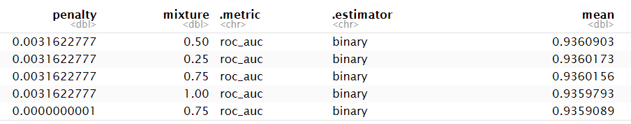
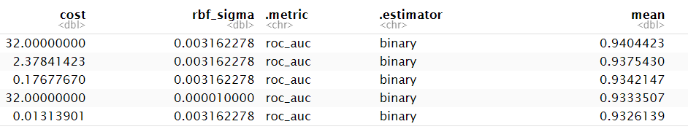
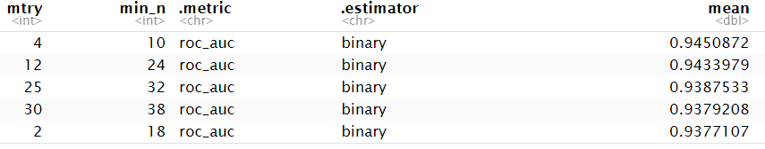
Model Comparison
Logistic Regression
SVM
Random Forest
Accuracy | 0.9067
Precision | 0.9150
Recall | 0.9617

Slide 12
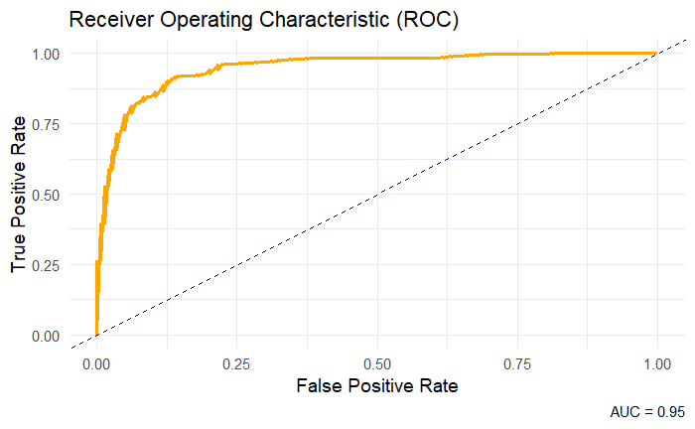

Slide 13
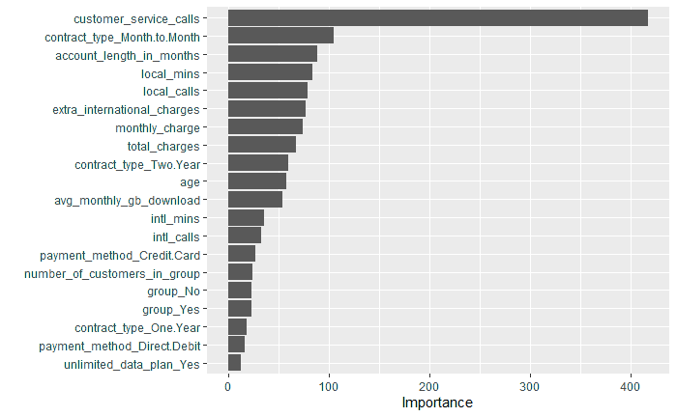
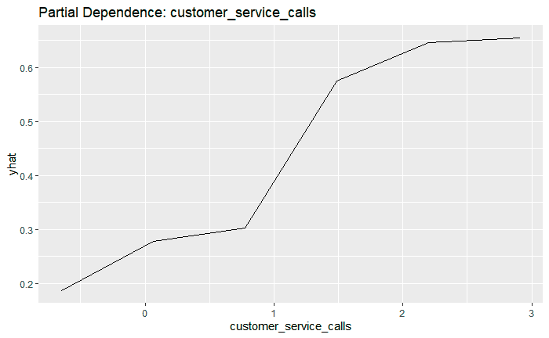
Global Model Explanations
Variable Importance Plot (VIP)
Ranked features by their contribution to churn prediction.
Partial Dependence Plot (PDP)
Showing the effect of a single feature prediction.

Slide 14
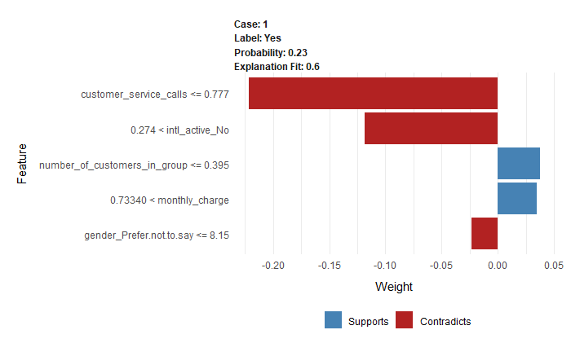
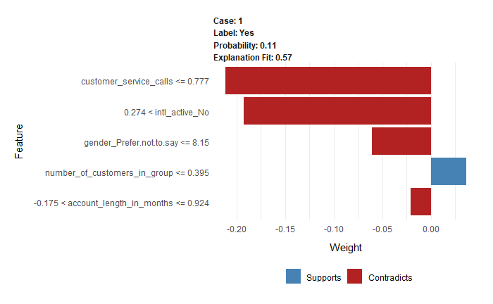

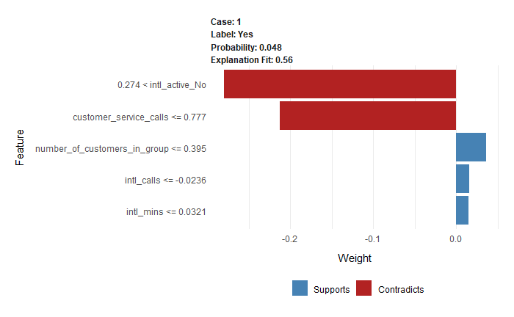
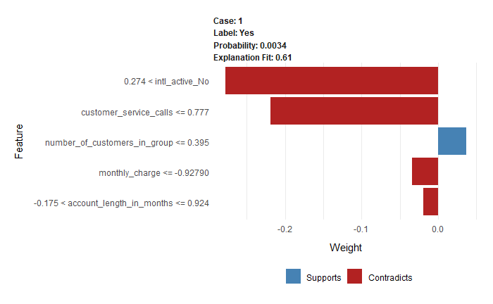
Local Explanations with LIME
LIME generates a simplified model around a single data point to explain why the model made a specific decision, show which features influenced the churn prediction for individual customer

Slide 15
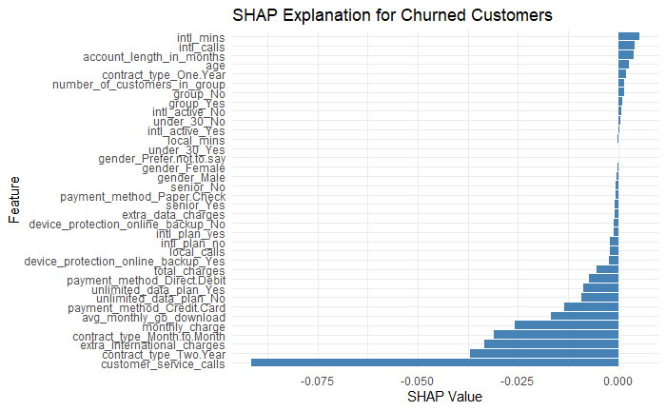
Local Explanations with SHAP
SHAP is a method that explains individual model predictions by showing how much each feature contributed to the final decision.

Slide 16
Thank you

